Slide 1
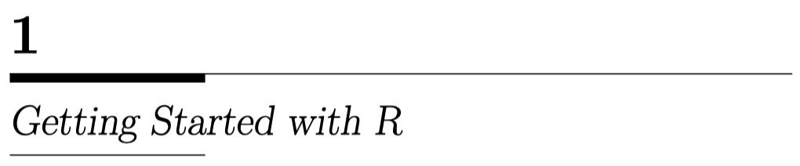
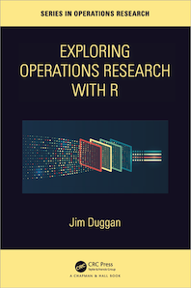
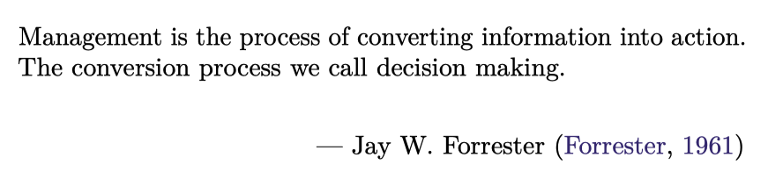

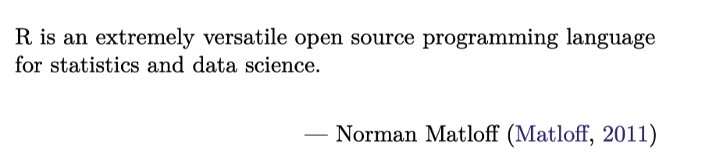
https://github.com/JimDuggan/explore_or

Slide 2


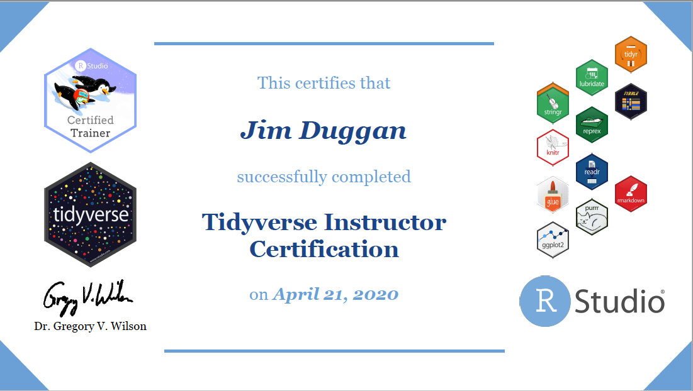
Instructor –Jim Duggan
Lectures in
Programming (R and Python),
Modelling & Simulation
Research interests:
System Dynamics
Computational Epidemiology
Data Science
GitHub link:
https://github.com/JimDuggan

Slide 3
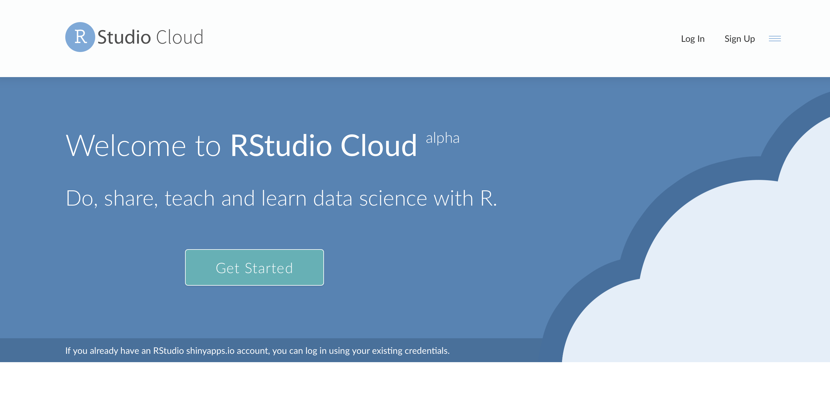
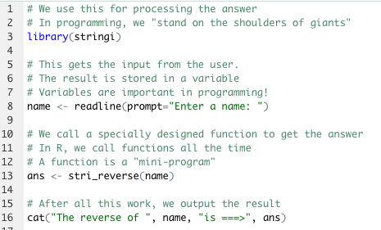
The R Project for Statistical Computing
R’s mission is to enable the best and most thorough exploration of data possible (Chambers 2008).
It is a dialect of the S language, developed at Bell Laboratories
ACM noted that S “will forever alter the way people analyze, visualize, and manipulate data”

Slide 4
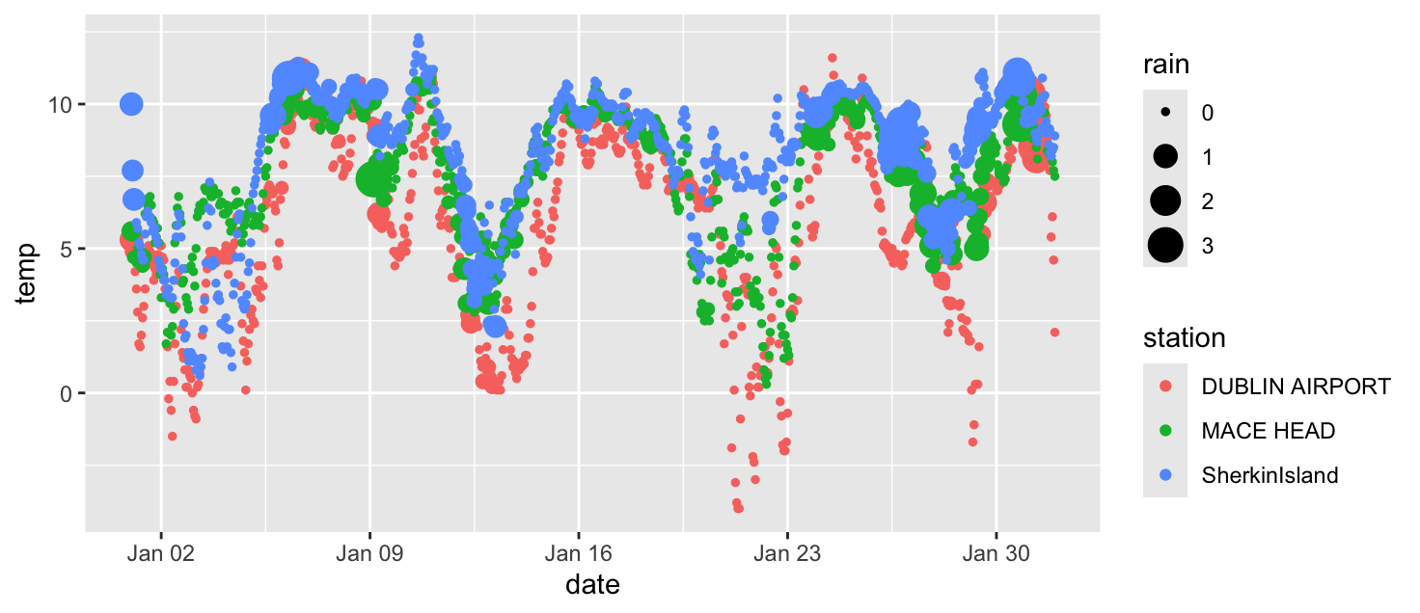
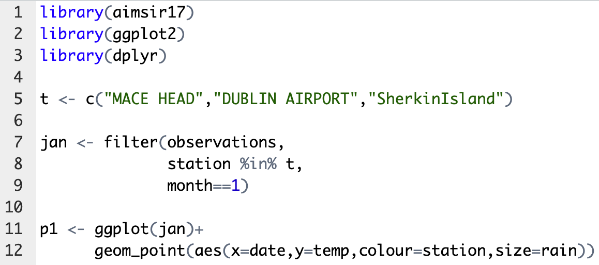
Overall Approach
Propose a Challenge
Code Solution (R Studio)
Explain R Concept(s)

Slide 5


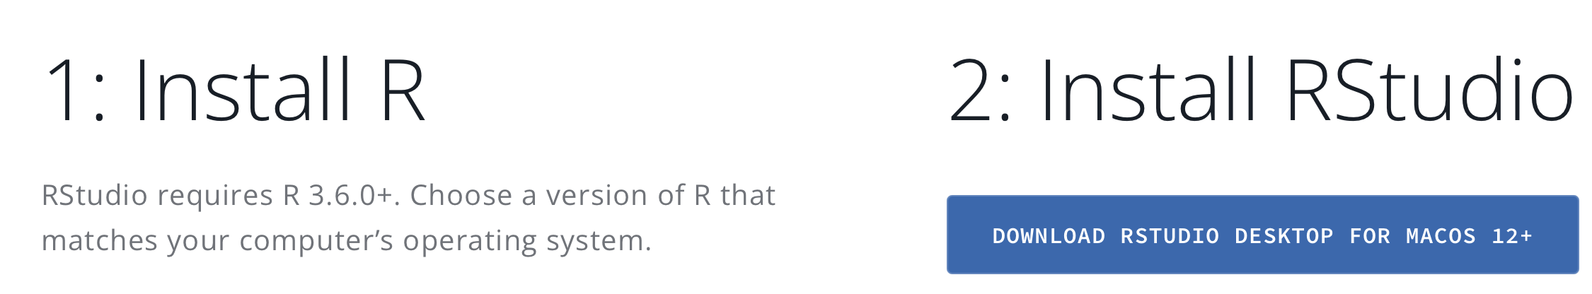
Choice of Integrated Development Environment (IDE)
https://posit.cloud
https://posit.co/download/rstudio-desktop/

Slide 6
Chapter 1 - Aims
Demonstrate the value of using the console to rapidly create variables, perform simple operations, and display the result
Show how to call functions
Comprehensive R Archive Network (CRAN)
Introduce two statistical R functions

Slide 7
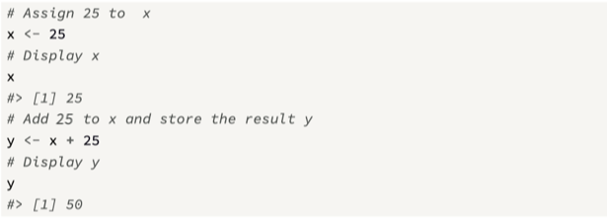
Interactive programming
An attractive feature of R is that it provides a console to support interactive programming, where the user can easily declare and manipulate variables.

Slide 8
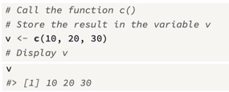
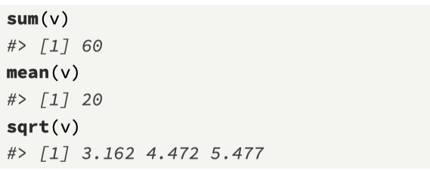
Calling functions in R
Functions are central to programming in R
There are two kinds of functions:
those available within base R*, and other libraries; and
functions written by programmers for their own use.
All functions take a set of arguments as input, and then return a result.
Results from functions are then assigned to variables using the assignment operator <-
The R function c() is used to create an atomic vector that can store one or more values
*The term base R is used to describe the core version of R

Slide 9
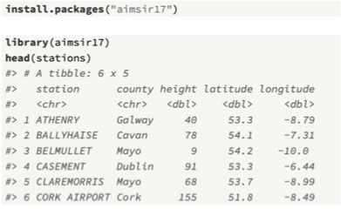
Installing Packages
A valuable feature of R is the ease with which new packages can be added, via CRAN.
Packages contain data and functions, and can be installed using the function install.packages(), or by highlighting the “Tools>Install Packages” option in RStudio.
Here we install the data package aimsir17, which contains Irish weather and energy grid data from 2017.
To load the package, we call the function library() with the package name as an argument.
The function head() displays the first six records

Slide 10
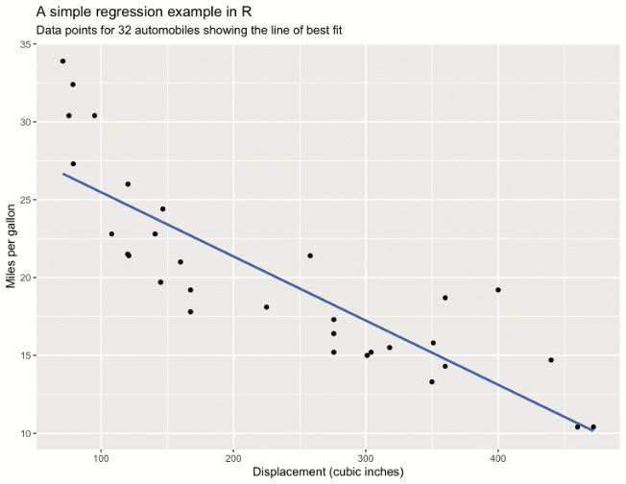
(1) A statistics function in R: linear regression
Regression analysis provides a way for predicting an outcome variable from either one input variable (simple regression) or several predictor variables (multiple regression)
The process involves generating a model that best describes the data
The solution process for simple regression is to search for two parameters (the regression coefficients) that describe the line of best fit, which are β₀ (the intercept) and β₁ (the slope)

Slide 11
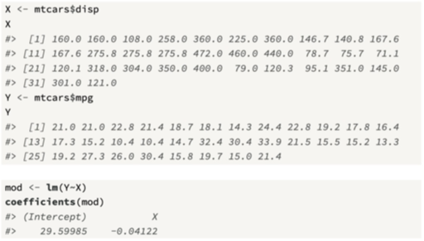
Calling the lm() function

Slide 12
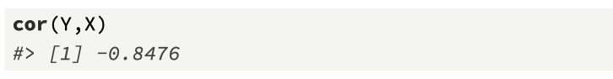
(2) A statistics function in R: Correlation
The correlation coefficient r is widely used to calculate the strength of the linear relationship between two variables, with −1 ≤ r ≤ 1 (Hoel and Jessen, 1971).
If r equals −1 or +1, then all the points on a scatterplot of the two variables will lie on a straight line.
the correlation measure can be valuable during the exploratory data analysis
In R, the correlation coefficient (the default is Pearson’s method) is calculated between two or more data streams using the function cor().

Slide 13
Course Structure
Part I (Base R) introduces R, and provides a step-by-step guide to the key features of R:
vectors, matrices, lists, data frames, and tibbles.
functions — are presented, along with important ideas including environments, functionals, and the S3 object system.
Part II (tidyverse), where the main focus is on five packages: ggplot2, dplyr, tidyr, and purrr.
Part III focuses on a practical example of using R to support an operations research method, system dynamics. It will include examples from a previous textbook, System Dynamics Modeling with R
SD
tidyverse
Base R

Slide 14
Recap
R’s mission is to enable the best and most thorough exploration of data possible (Chambers 2008)
Interactive console valuable
In R, functions are core
Installing CRAN packages is straightforward
Two useful stats functions: lm() and cor()
Next Challenge: Installing a package
Next Topic: vectors

Slide 15
Challenge 1.1
Install the package nycflights13
Explore the variable flights
Use summary() to gain some insights

